Slide 1
SHORT FORM CONTENT

Slide 2
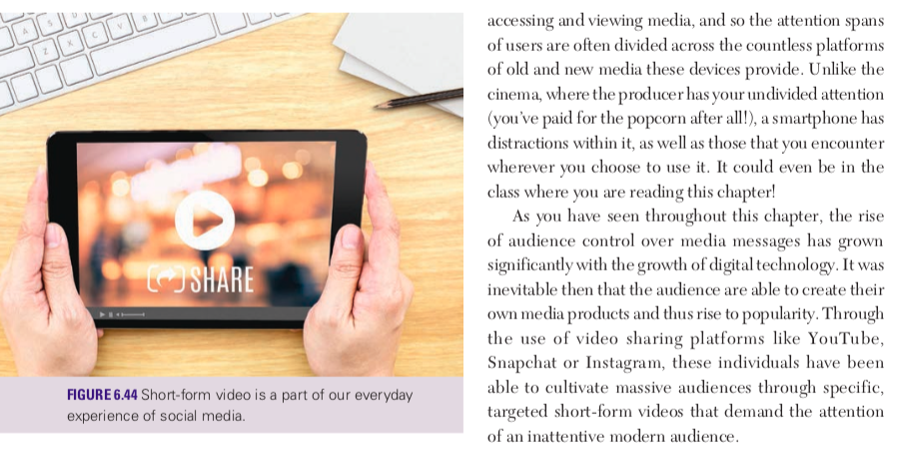

Slide 3
SHORT FORM CONTENT

Slide 4
FOCUS QUESTION

Slide 5
TOP 15 YOUTUBE CHANNELS,

Slide 6
SHORT FORM CONTENT
Or following this link

Slide 7
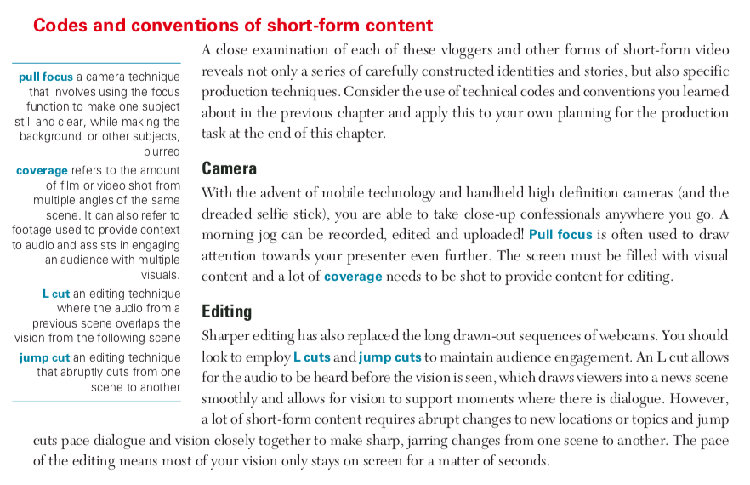

Slide 8
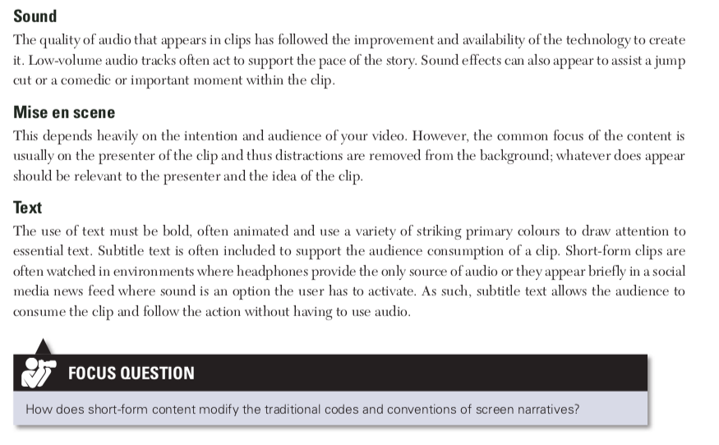

Slide 11
SHORT FORM CONTENT PROCESS
Or following this link

Slide 12
SHORT FORM TRANSITIONS
Or follow this link

Slide 13
SHORT FORM SOUND
Or follow this link

Slide 14
SHORT FORM NARRATIVE EXAMPLE
Or follow this link

Slide 15
PRODUCTION EXERCISE

Slide 16
POST PRODUCTION PLANNING
Use the digital workbook in Google classroom to plan your production
Create a story board
Location list
Script

