Slide 1
The Documentary
Year 9-10 Cinematography

Slide 2
What is a Documentary ?
A documentary film is a non-fictional motion-picture intended to "document reality, primarily for the purposes of instruction, education, or maintaining a historical record" Documentary films, originally called "actuality films", lasted one minute, or less. Over time, documentaries have evolved to become longer in length, and to include more categories; some examples being: educational, observational, and docufiction..
Social-media platforms (such as YouTube) have provided an avenue for the growth of the documentary-film genre. These platforms have increased the distribution area and ease-of-accessibility; thereby enhancing the ability to educate a larger volume of viewers, and broadening the reach of persons who receive that information

Slide 3
Documentary
To DOCUMENT something, means to capture it. To write it down, photograph it, record it or video it. You are taking a small piece of real life and keeping a record of it. This may be just for yourself – the way we do with diaries. It may be to share with others – like on Facebook or Instagram.
Or it may be to share information with a much wider audience – the way film and television documentaries do.
Documentaries usually have a similar intention – to INFORM the viewer about something they might not already know. Sometimes they also want to PERSUADE the viewer to have a particular point of view.

Slide 4
What defines Documentary
A broad category of film or television show that attempts to “document” some aspect of reality
lNon-fiction (true), un-staged
lPresents “life as it is” or “a factual film that is dramatic”
lCan use various methods such as observation, interviews, narration and has an artistic element
lAttempts to inform or get us to think about an issue in real life
.

Slide 5
The Purpose of a Documentary
lPortray real life
lFocus on an issue or truth
lAttempt to:
bring about awareness of an issue
inform or teach
record, reveal or preserve
analyze, interrogate
persuade, promote
To engage

Slide 6
Making a Documentary
Before a filmmaker can make their own documentary, it is important to watch several and do two things:
– Break down the elements of the craft so that you know how to make a good documentary that does what you want it to do.
– Break down the content of the documentary so that you can learn how to decide what information to put into your film.
But how do we analyse a DOCUMENTARY? Well, we do a focused viewing where we ask questions as we watch, taking notes and discussing what we nd with each other at the end.

Slide 7
Types of Documentaries
Reflexive: Purpose: To explore and experiment with the form of documentary (the aesthetic aspects)
Experimental, “art” form
Draws attention to the art of documenting
Uses an artistic form to represent an idea
Example: Ryan (focuses on animation techniques to depict an artist’s life), How I Met the Walrus (illustrates the words of an interview with John Lennon)
View reflexive example

Slide 8
Type - Expository
Purpose: To propose an argument or deliver an interpretation
Investigative (fact-finding, journalistic)
Essay style (collects evidence, then proposes an argument)
Usually authoritative narration explains content (this is called voiceover)
Can be descriptive, informative, persuasive, didactic
Visuals complement the information being spoken, but they are not the central focus: what is being said is important
Examples: An Inconvenient Truth, Are We Safer?, Football High
View sample

Slide 9
Type - Observational
Purpose: To observe aspects of life with minimal interference or manipulation
Filmmaker is like a “fly on the wall”
The cameras and film crew seem not to be disturbing the scene or even be noticed by the participants
Camera follows action that is beyond the control of the filmmaker
The story unfolds in chronological order
The filmmaker’s point of view is hidden in the narrative structure
Techniques: subjects speak to one another
Example: Babies, The Cove, Armadillo
View sample

Slide 10
Type – Interactive/Participatory
Purpose: To interact with the subject directly in order to study it
Film-maker’s presence is obvious
Includes interviews, editing, questions to the audience
Manipulates and (mis) interprets events
Examples: Bowling for Columbine, The Dark Side of Chocolate
View sample

Slide 11
Type - Performative
Purpose: To explore or produce subjective emotional responses to the world
Similar to interactive, but less objective (filmmaker constructs subjective truths)
The filmmaker, who is the subject of the film, undergoes some sort of physical process solely for the purposes of making the film (source: HotDocs Library)
Topic is usually something personal to the film-maker
Subject speaks directly to the camera or in voice-over
Examples: No Impact Man, Beyond the Horizon, SuperSize Me
View sample

Slide 12
Poetic Documentary
First seen in the 1920s, poetic documentaries are very much what they sound like. They focus on experiences, images, and showing the audience the world through a different set of eyes.
Abstract and loose with narrative, the poetic sub-genre can be very unconventional and experimental in form and content. The ultimate goal is to create a feeling rather than a truth.
For filmmakers, this approach offers a valuable lesson in experimenting with all the elements of documentary filmmaking by finding creative compositions, challenging juxtapositions, and different forms of cinematic storytelling
View sample

Slide 13
Mockumentary
A film or television program that is shot like a documentary but is fictitious and usually satirical.
The term mockumentary is a portmanteau of mock and documentary.
Satirical
Funny/Humorous
Fictitious
Sometimes Political
Thought provoking
Sample

Slide 14
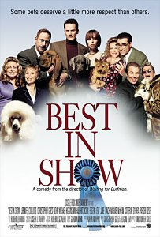
Characters
Interviewer/camera crew
Subject (sports team/athlete, celebrity, political figure, newscaster, etc…)
Rock Band : Office Workers
Storylines
Serialized installments of the ‘everyday’
The Office
Spinal Tap
Curb Your Enthusiasm
The events surrounding a ‘big event’
Best in Show
A Mighty Wind
Waiting for Guffman
Cataloging the events of a journey
-Borat

Slide 15
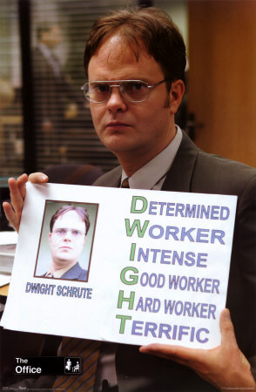
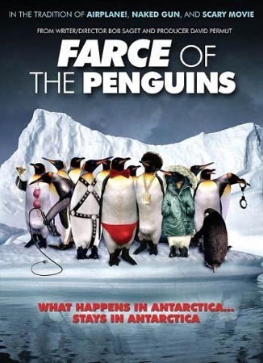
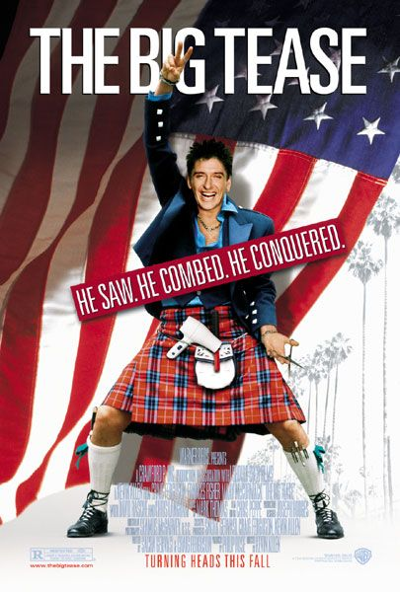
Value Assumptions
Life is funny.
Humor can be created anywhere out of anything.
People, for all of their weirdness, can learn to live together.
Eccentricity is mocked and celebrated

Slide 16
QUESTIONS that it is good to ask of a DOCUMENTARY are:
TASK 1 : Select one documentary on the following page and answer the following
What is the main focus of the documentary? Is it trying to inform us about something or persuade us to believe or do something?
What style is used? Is it an unfolding story, an interview based documentary, a dramatic recreation? Are there interviews, narration or dramatic recreations?
Is the documentary promoting any particular viewpoint?
Does the lm making use a variety of different shots to shoot the lm or is the camera usually in just one place?
Does the documentary use moving footage or still photographs or both? Which of these is the most interesting to you? Why?
What sort of music and sound e ects does the documentary use? Does the lm succeed in sharing information? Is it also interesting and entertaining? Why or why not?
After watching this documentary, think about meaning. How is it created by the shots, story, music and audio of the lm?

Slide 17
Task One View Documentaries
Ball Art
Into the Woods
An idiot Abroad
Times Square
Gambling in Las Vegas
Best in Show

Slide 18
The Documentary
Film Techniques

Slide 19
Methods of Development
Narration: telling stories or anecdotes to illustrate a point or show the seriousness of an issue
Description: characteristics or features of the unfamiliar are described
Examples: illustrations of a concept, event, idea are given
Classification: ideas are grouped in categories to show or explain a bigger idea

Slide 20
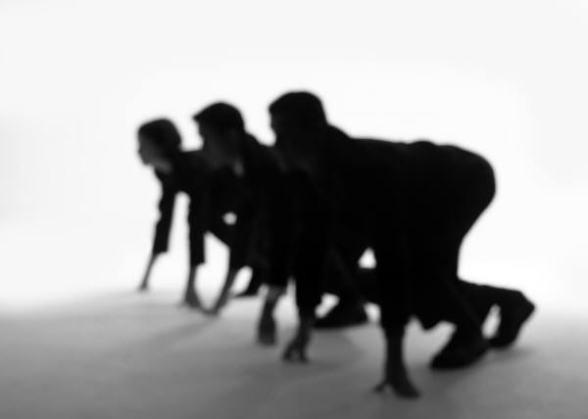
Exposition
In a documentary, the exposition occurs at the beginning and introduces the important themes of the film. It is important because it creates the viewer's first impression and introduces the viewer to the content.

Slide 21
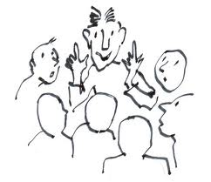
Direct Narration
We see and hear the narrator of the film as the narration is presented; suggests an intimacy between narrator and audience; this type of narration is seldom objective‑‑its biases reflect the speaker's background, conflicts, values)

Slide 22
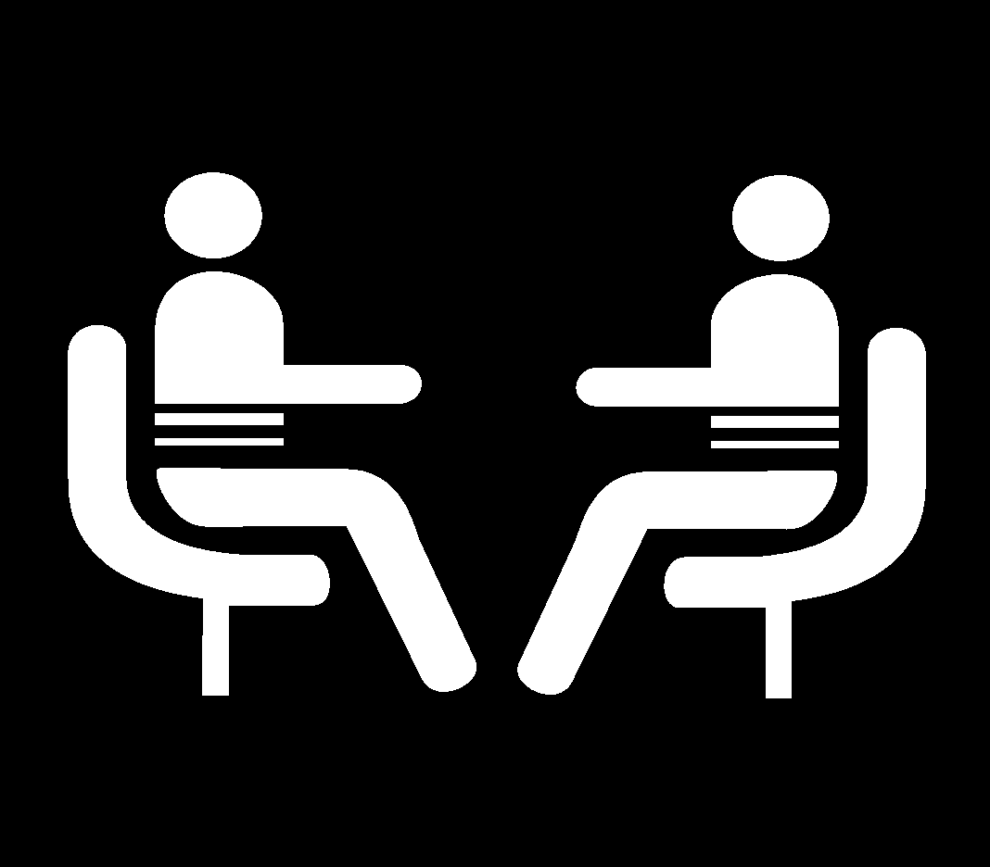
Interviews
The interview is a common documentary technique. It allows people being filmed to speak directly about events, prompted by the questions asked by the filmmaker.
An interview may take place on screen, or off screen, on a different set. Interviews in a documentary give the viewer a sense of realism, that the documentary maker’s views are mutually shared by another person or source, and thus more valid.

Slide 23
Indirect & Direct Interview Technique
Indirect: We see subject talking on camera, but we don't see or hear the interviewer asking questions in the same shot; this gives the impression of the character speaking directly to the viewer.
Direct: We see subject talking on camera, and we see and hear the interviewer asking questions in the same shot or in part B of a two‑part parallel track; suggests journalistic basis of reporting).

Slide 24
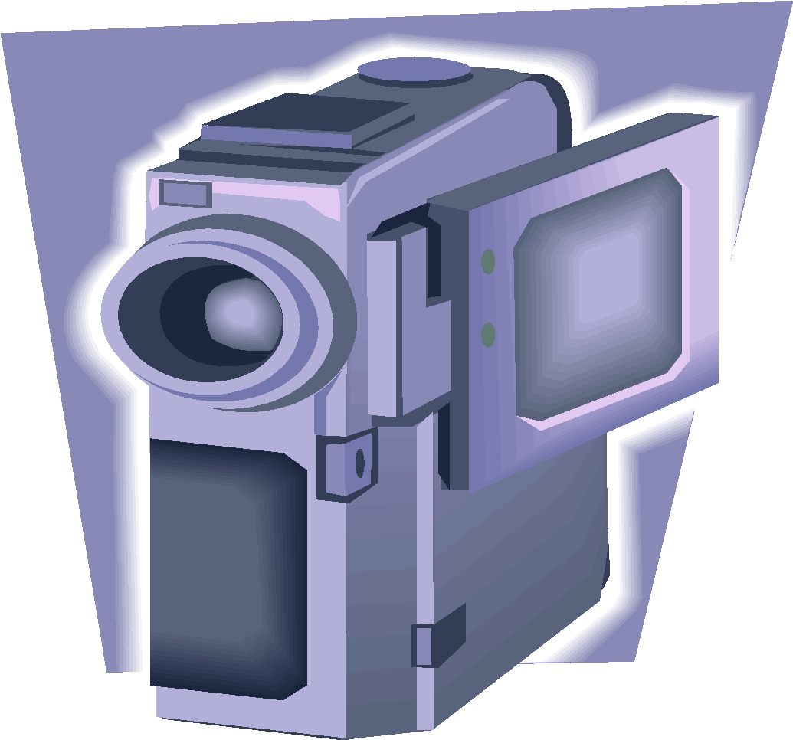
Point of View Shot
(Often abbreviated as 'pov'). A shot which shows the scene from the specific point of view of one of the characters.

Slide 25
Flash-Forward
On the model of the flashback, scenes or shots of future time; the future tense of the film.

Slide 26
Flashback
A scene or sequence (sometime an entire film), that is inserted into a scene in "present" time and that deals with the past. The flashback is the past tense of the film.

Slide 27
Montage
An edited sequence that elicits a strong emotional reaction on the part of the viewer; often used as transitional or climactic sequences; static shots.

Slide 28
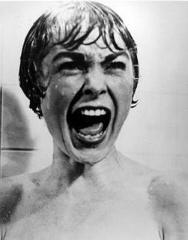
Reaction Shot
A primary means of conveying meaning within the context of narrative is through the use of a reaction shot--a medium shot or close-up of a character/person just after significant action occurs within the scene.

Slide 29
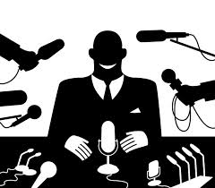
Talking Head
The image of a person, as on a television documentary or news show, who talks at length directly to the camera and usually appears on the screen with only the head and upper part of the body visible.

Slide 30
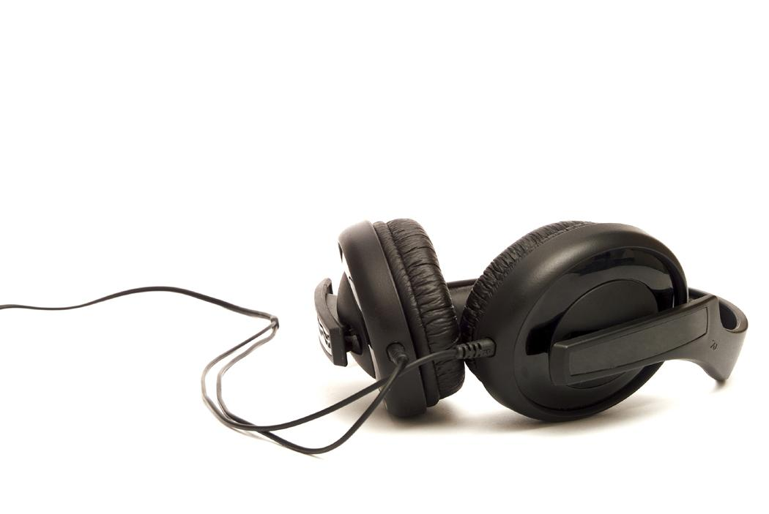
Sound
Diegetic sound: It is sound that the characters can hear as well as the audience, and usually implies a reaction from the character. Also called "literal sound" or "actual sound“
Examples: voices of characters or sounds within the story

Slide 31
Sound
Non-diegetic sound: It is sound which is represented as coming from a source outside the story space, i.e. its source is neither visible on the screen, nor has been implied to be present in the action. Also called "non-literal sound" or "commentary sound":
Examples: Narrator’s commentary, voice-over and music

Slide 32
The Voice Over
the voice over in a documentary is a commentary by the filmmaker, spoken while the camera is filming, or added to the soundtrack during the production. Through this the filmmaker can speak directly to the viewer, offering information, explanations and opinions.

Slide 33
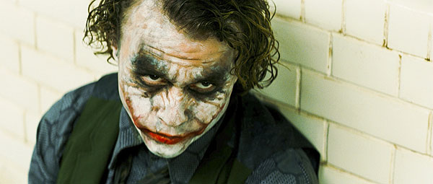
Close Up Shot
One way filmmakers break down narrative scenes is by inserting a close-up in an unexpected context; when this is done the shot is often a close-up in order to draw our attention to the image/object and facilitate our judgment of the action.

Slide 34
Bias and Atmosphere .
Bias
We trust the film-maker to be objective (unbiased) and seek the absolute truth
As viewers, we need to ask the question: Are film-makers fair to each side of the argument?
Atmosphere
Mood or tone of each scene or interview or overall film
What kinds of techniques are used to create atmosphere?

Slide 35
Documentary Filmmaking Techniques (cont’d)
Masked Interview: an interview in which the filmmaker is both unseen and unheard
Archival Footage: material obtained from a film library or archive and inserted into a documentary to show historical events
Reconstructions: artificial scenes portraying an event (have been reconstructed and acted out based on information about the event)

Slide 36
How to conduct a documentary Interview
Prepare your questions Think ahead about the type of questions you want to ask your interviewee. What kind of information are you looking for from this particular person and what are the type of questions that will best get them to give you the information you’re looking for? No need to go crazy. 5-10 questions is usually enough.
Avoid “yes” or “no” answers Your questions should be asked in such a way that you won’t get “yes” or “no” answers. You need your documentary interviewees to give you substantive answers that you can use in your video edits. Instead of “Are you happy with the outcome of the court case?” Ask, “What is your response to the outcome of today’s court case?
Questions that begin with Who What When Where Why and How will always illicit more detailed responses

Slide 37
Don’t give out specific questions in advance I cannot stress this point strongly enough. It’s perfectly acceptable to give someone a general idea of what the interview will be about, but do not give them your list of questions.
Have them repeat your question This is a great idea, especially if you plan to have no narration for your documentary. Get the person to repeat back your question in their answer.
Ask for final comment Here's a great video interviewing tip: at the end of the interview, always ask the person if they have any final thoughts.
Don’t stop filming when the interview is “over” Especially when you have someone who is nervous and never got quite comfortable with the interview.

Slide 38
Documentary Task 2
Produce a documentary in your chosen style based on New Media Technology . Use the workbook to plan develop and create your Documentary
Other topics
Produce a documentary on Covid 19
Produce a 5 minute documentary film on a fictional star/celebrity who is a popular culture icon. The documentary needs to persuade the audience to take on an identifiable viewpoint, either positive or negative, in regards to that star/celebrity
Produce a documentary or mockumentary on a particular interest or hobby of yours

Slide 39
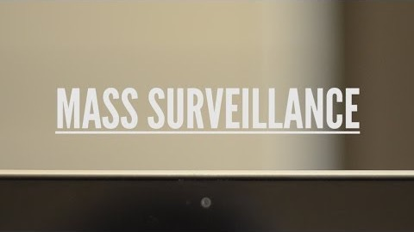
New Media Technology Documentary Sample
Or view this documentary here

Slide 40
The Workflow
Access your digital workbook
Select your topic
Engage in research
Write a series of questions
Write a treatment /script
Complete shot list 3 column template
List your questions
Submit digital workbook
Film your footage : Interviews
Edit – Titles Sound

