Slide 1
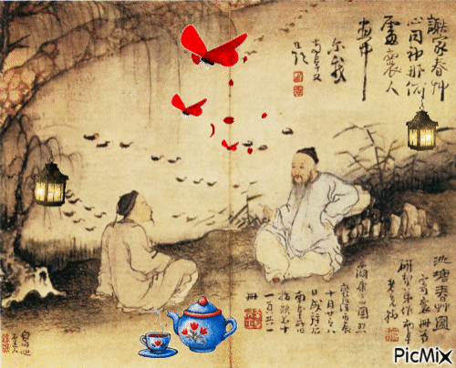
Death, Funeral Customs Contact and Conflict

Slide 2
This Week in year 7 History
You MUST read and respond to slides 1 – 11 and complete Tasks 1-3
You SHOULD read and respond to slides 12-13 and complete Task 4
You COULD read and respond to slide 14 and complete Task 5

Slide 3
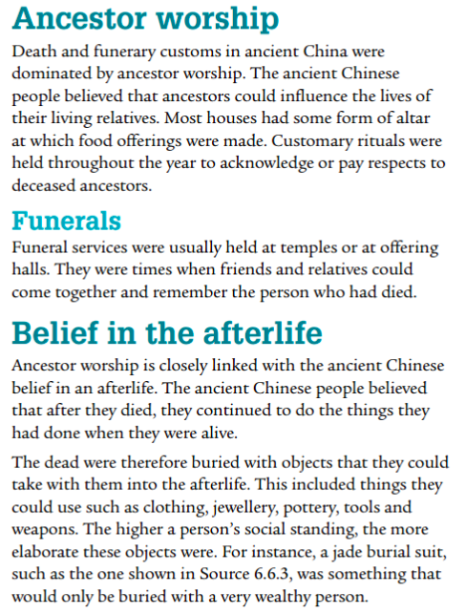
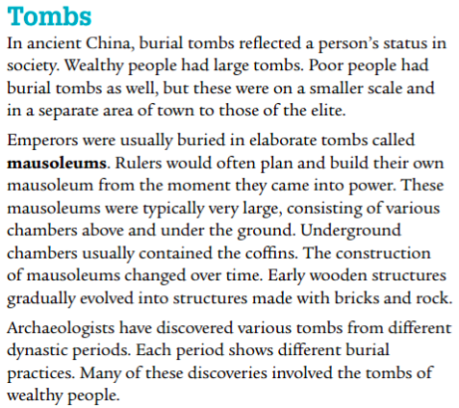
Funeral Customs
Read Pearson p 162

Slide 4
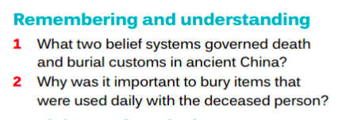
Task One
In your workbook answer questions 1 and 2

Slide 5
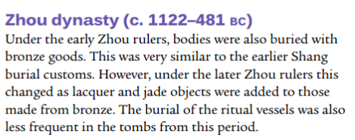
TOMBS OF THE CHINESE DYNASTIES
Read Pearson p 162-163

Slide 6
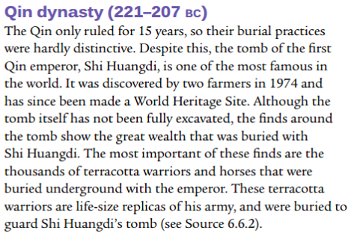
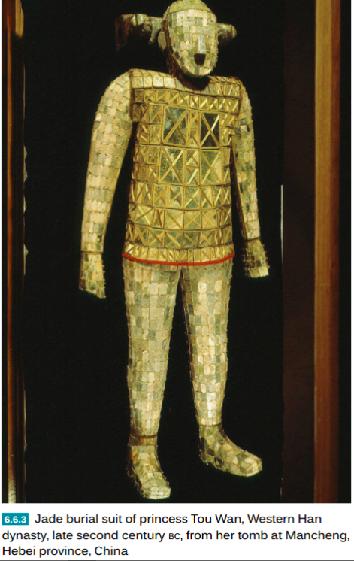
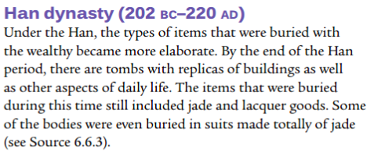

Slide 7
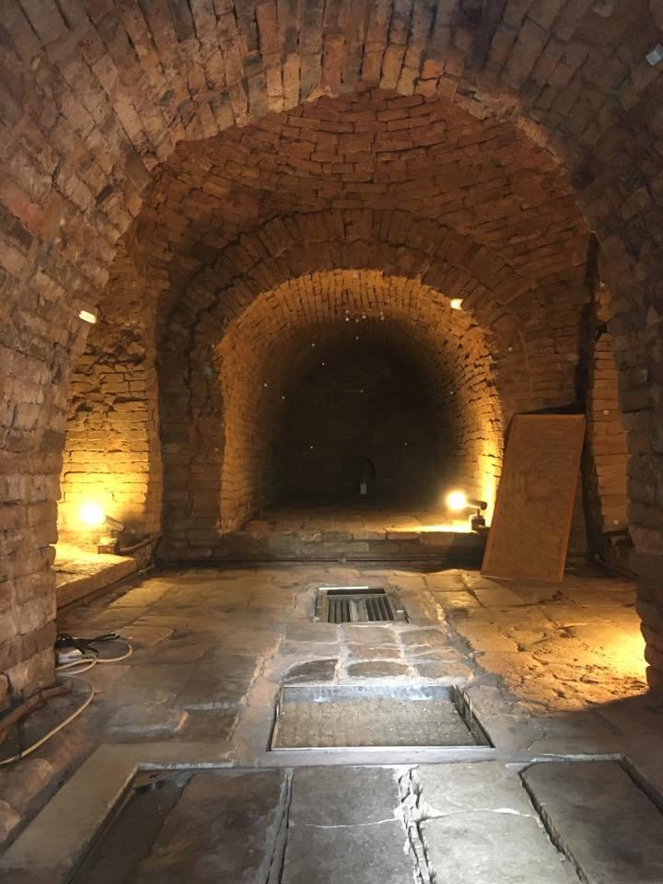
Task 2
In Your Workbook answer Q 3 , 4a and 4b
3.Compile a list of what an archaeologist might find inside the tomb of an ancient Chinese person ( apart from a coffin)
4a What Types of tombs are normally found by Archaeologists'
4b How useful would tombs be to historians of ancient China ? Explain your answer

Slide 8
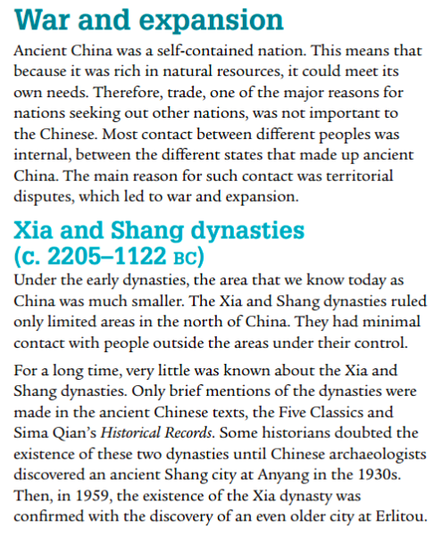
Contact and Conflict
View the video by clicking on the image

Slide 9
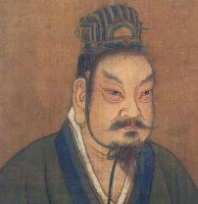
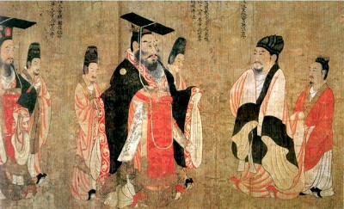
Zhou Dynasty
Click the image to play video

Slide 10
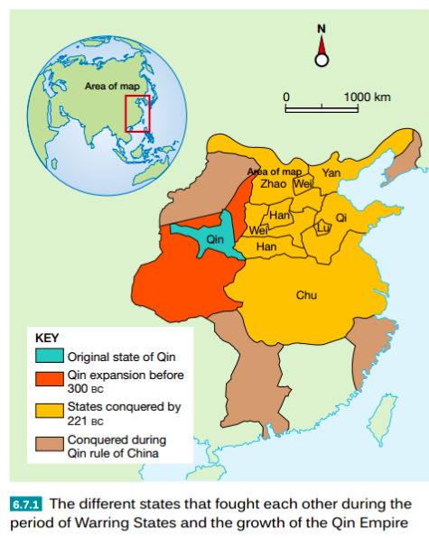
The Warring States
Click on the map to view video

Slide 11
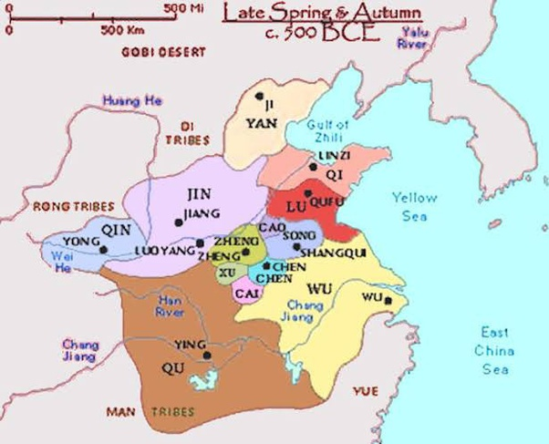
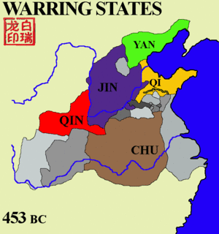
TASK 3
In your digital workbook create your own map of the warring states

Slide 12
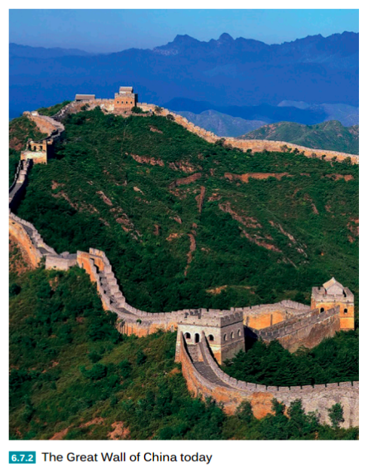
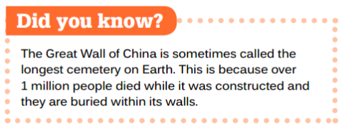

Slide 13
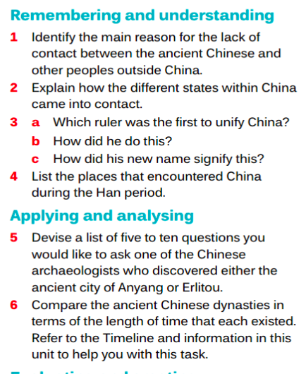
TASK 4
Answer the following in your workbook

Slide 14
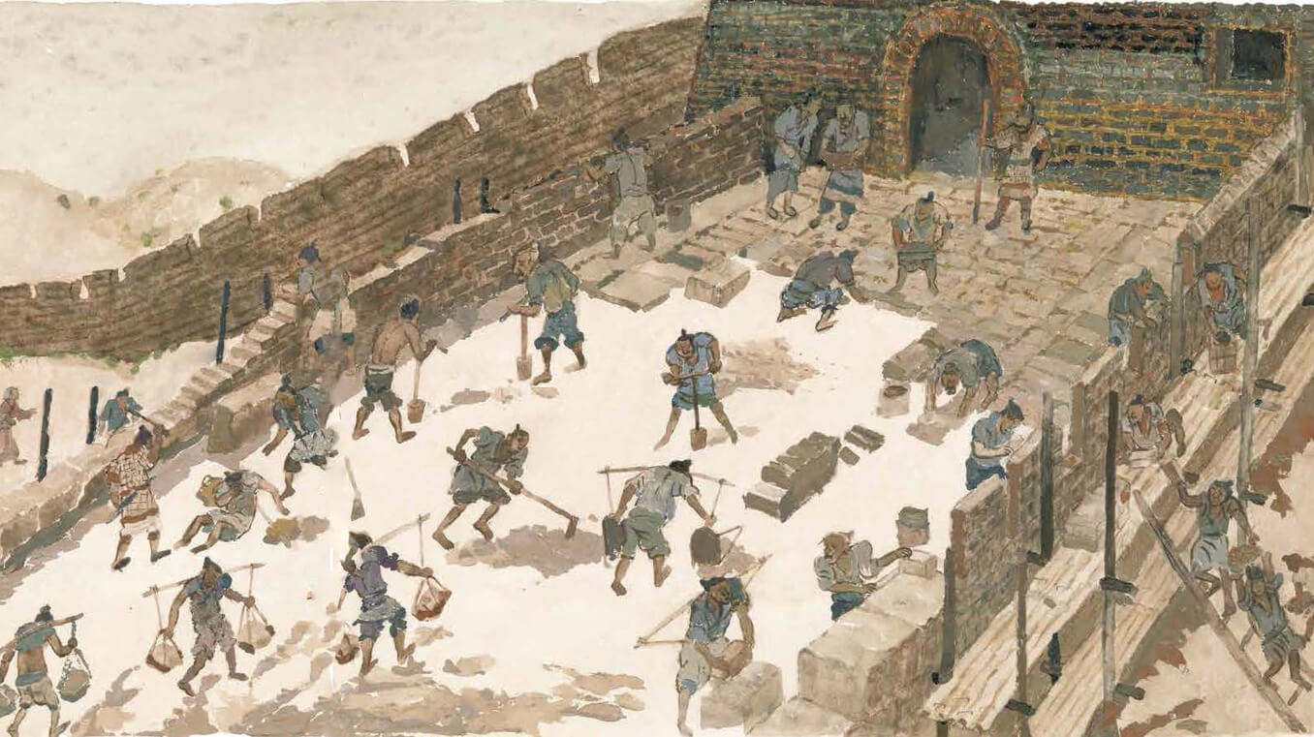
TASK 5
View the video and provide a written response to question 7
Click on the image to play the video

