Slide 1
Film Studies:
Context
This lesson introduces students to Mise en scene and how it applies to the composition of the film
This area of coursework would generally occur within week 2 - 3 of the film studies course by which time students had been introduced to the Narrative construction of film and Genre
Students should have had the opportunity view the film in its entirety
To assist in students understanding of the Narrative they review this PowerPoint presentation providing definition and elements of mise en scene. This is complemented by class discussion/ and extracts from the film
Students review sequences from the film and address specific questions to discuss and analyse how mise en scene contributes to the Narrative

Slide 2
Learning Outcomes
Demonstrate an understanding of mise en scene and how it applies to the composition of the film
Recognise and identify the elements of mise en scene in the film and how they contribute to plot and theme
Demonstrate the ability to provide written responses identifying and analysing the use and effect of mise en scene in the film

Slide 3
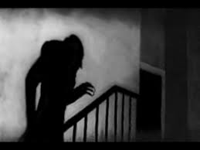
A Definition of Mise en scene
What is mise-en-scène?
The French term 'mise-en-scène', translating as "staging" or "putting into the scene/on the stage", generally refers to all 'pro-filmic elements' on the set "that can be seen within the frame of the individual shot" (Benyahia et al. 2008: 21).
The term refers to the visual arrangement of items on screen
Mise-en-scene also takes into account how those items affect the atmosphere of the shot

Slide 4
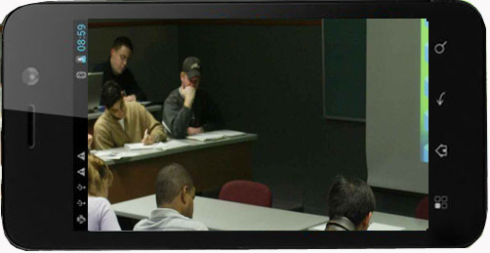
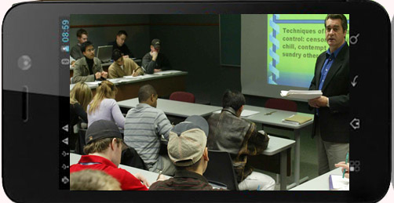
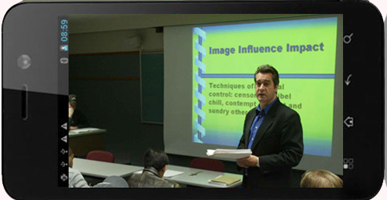
Mise en scene
Using your mobile phone camera option and zoom
function you can alter composition and meaning of the subject
Camera framing and shot selection are also argued by some to include film specific -elements such as framing and camera movement
This encompasses both what the audience can see , and the way in which we are invited to see it

Slide 5
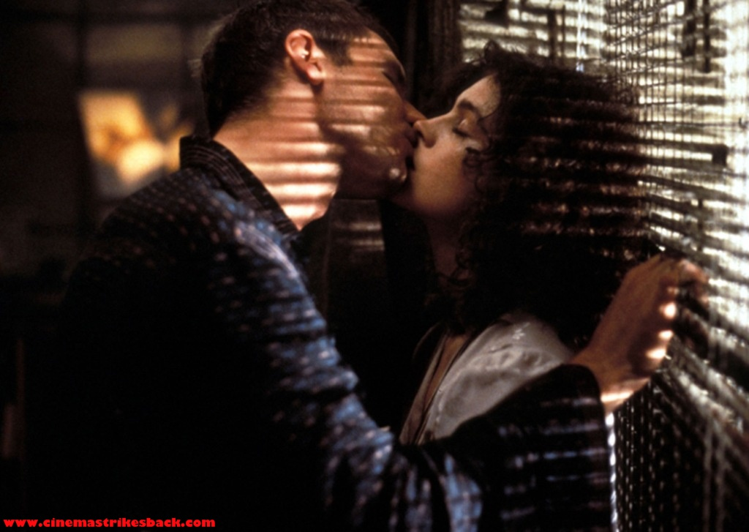
Elements of Mise en scene
The theory in this presentation is based on the very common definition of mise-en-scène as expressed in Film Art (1979) by David Bordwell and Kristin Thompson.
In film production it is the director who has control not only of the camera framing but of the visual elements that appear in the film frame.
Mise en scene refers to the overall effect of
Setting
Lighting/ Color
Costume
Figure expression and movement

Slide 6
Blade Runner
Blade Runner is a Science Fiction Noir directed by Ridley Scott and released in 1982.
Ridley Scott managed to create a very strong identity and aesthetic for blade runner with exceptional use of the films Mise-en-scene. This allows us, the audience, to derive meaning from the films visual elements. The setting, costumes and lighting of Blade Runner are deeply intertwined with its plot and themes.
Blade Runner revolves around the themes of dehumanization of people resulting from a society based around high technology and the notion of what it means to exist as a human being. The mise-en-scene of Blade Runner is not only appropriate to its overriding themes but it is vital in the establishment and expansion of these themes within the text.
Blade Runner can be looked at as having two overarching themes. The film depicts a society in which the proliferation and excess of high technology serves as a dehumanizing force. Within this environment in which human life no longer seems to be of utmost importance the question of what exactly it means to be human is entrenched within the film text.
Students view opening sequences from Blade Runner

Slide 7
Setting
“The human being is all-important in the theatre. The drama on the screen can exist without actors. A banging door, a leaf in the wind, waves beating on the shore can heighten the dramatic effect. Some film masterpieces use man only as an accessory, like an extra, or in counterpoint to nature, which is the true leading character.”
Andre Bazin
French film critic and film theorist.

Slide 8
Setting
This aspect of mise-en-scene invites the film maker to select a natural or artificial locale where the set is constructed
setting functions variously to orient viewers, to contribute dramatic impact, and to add meaning to the film’s narrative
Setting’s ability to add meaning to narrative implies that props—part of the setting given specific significance in the total action—are also part of the control directors dictate in film art

Slide 9
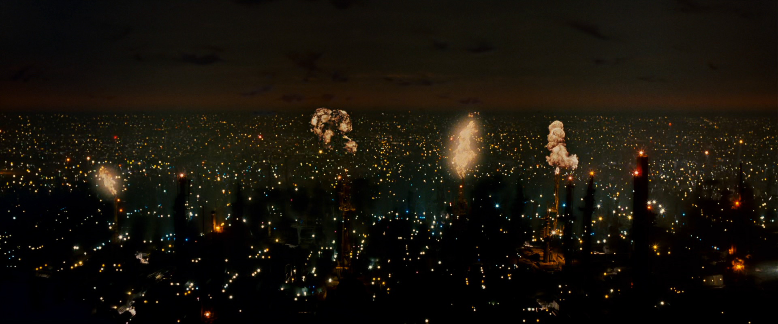
Setting
Describe and explain how the setting represents the futuristic landscape of Los Angeles in the opening of Blade Runner
Doe the setting established in the opening reflect Bazin’s view

Slide 10
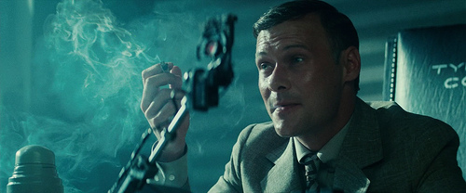
Setting
3. What is the name and function of the machine, Blade Runner Holden administers to Leon. Research and explain the origins of the machine

Slide 11
Costume
Costume, or clothing and its accessories, is also an important visual element in film.
Directors concerned with historical reality often go to great lengths to research clothing style, textile, and dye likely to be used by characters of a certain era, for costume is an indispensable means of establishing authenticity.
Costume can serve to enhance the narrative, or story, for instance, by suggesting social position of characters.
Costume also can hint at character development in the film

Slide 12
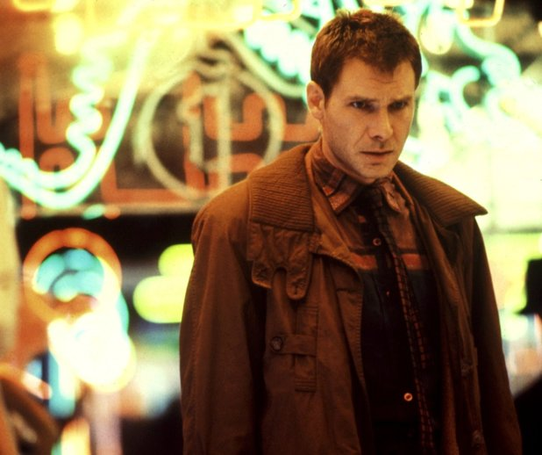
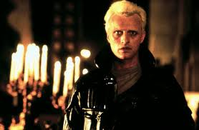
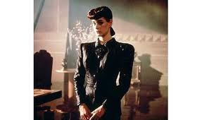
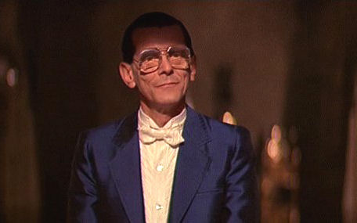
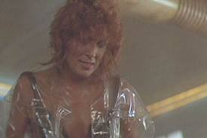
Costume
5. Describe one characters costume as agent of representation

Slide 13
Lighting
Lighting, like the other aspects of mise-en-scene, is a tool used by the director to convey special meaning about a character or the narrative to the viewer.
Lighting can help define the setting of a scene or accentuate the behavior of the figures in the film
The quality of lighting in a scene can be achieved by manipulating the quality and the direction of the light.
There are five primary types of directional lighting: frontal lighting, side lighting, back lighting, under lighting, and top lighting

Slide 14
Lighting Position
Frontal lighting is where the light source is directly behind the viewer's point of view. Front lighting does little to reveal form or texture since the shadows are mostly hidden from view; as a result it can make things look flat. However soft diffused frontal lighting can also be quite flattering to some subjects for this very reason
Side Lighting is very good for showing form and texture and lends a three-dimensional quality to objects. Shadows are prominent and contrast can be high as a result. Side lighting can be used to throw dramatic shadows onto surfaces such as walls and create atmosphere.

Slide 15
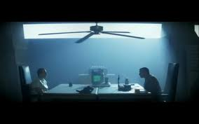
Lighting Position
Backlighting is where the viewer is looking into the light source, and objects will have their lit sides facing away from us to appear either as silhouettes or darkly lit by the fill light. It is usually a high contrast situation and can often look very atmospheric and dramatic.
Top Lighting is often used to provide fill to other light sources. Independently as soft light it is an effective way of showing form. Under hard light it can lend an air of mystery by casting dramatic shadows which conceal most of the forms beneath them:

Slide 16
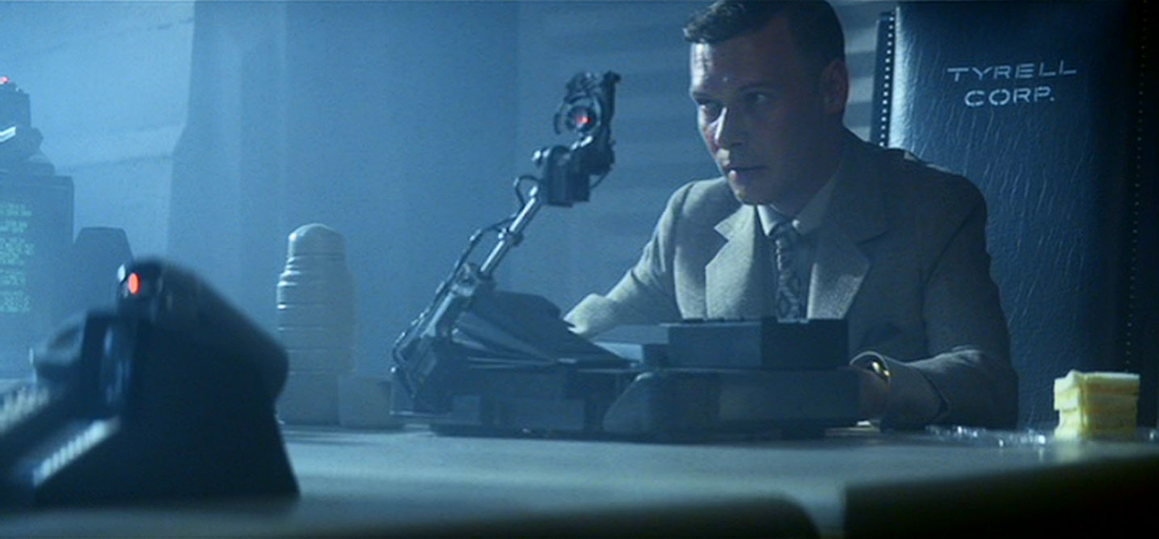
Lighting Position
Under Lighting suggests that the light comes from below the subject. Under lighting tends to distort features and is often used to create dramatic horror effects
Tinted Light is created by filters during production to color a scene for dramatic effect. In the scene where Holden interrogates Roy grey filtered light is used to accent the films dull metal color scheme and postindustrial look

Slide 17
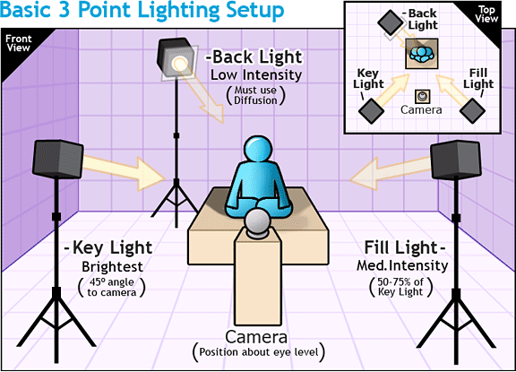
Lighting
Classical Hollywood filmmaking developed the custom of using at least three light sources per shot:
Key light: comes diagonally from the front
Fill light: from a position near the camera
Backlight from behind and above the figure

Slide 18
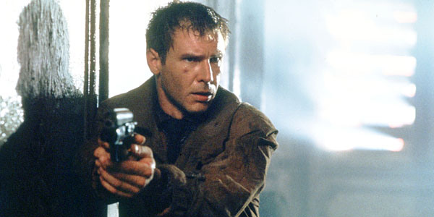
Lighting
BACK
LIGHT
FILLER LIGHTS
KEY LIGHT

Slide 19
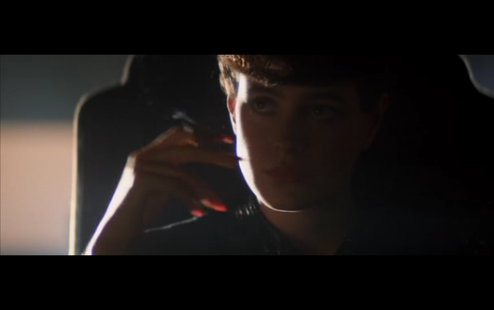
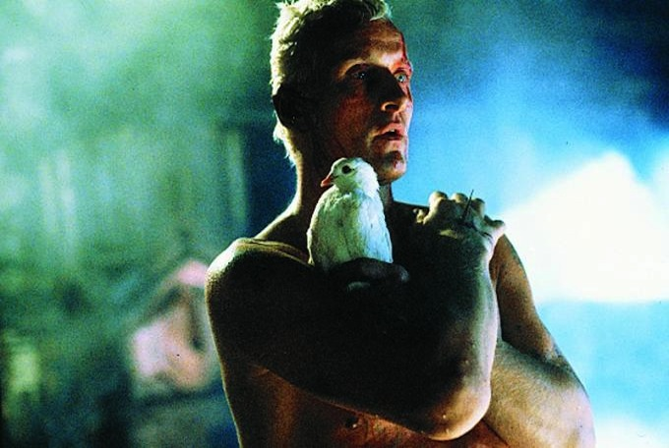
Lighting
LOW KEY LIGHTING
Creates stronger contrasts and sharper darker shadows
Often the lighting is hard and fill lights are eliminated all together
Deep, distinct shadows/silhouettes are formed

Slide 20
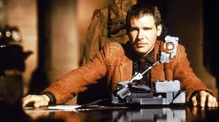
Lighting
HIGH KEY LIGHTING:
More filler lights are used. Lighting is natural and realistic to our eyes
Produces brightly lit sets or a sunny day (right)

Slide 21
Lighting
Lighting in Film Noir
Film noir is characterised by a visual style in which dark and dangerous rain washed city streets provide the setting for crime and corruption
The lighting in film noir reflects its themes. Chiaroscuro low key lighting creates deep shadows in which characters can physically and metaphorically hide, their motivations and actions thus obscured
Lighting is the most distinctive feature of film noir with highly contrasted areas of light and shade. Dramatic patterns of light and shade are created by light filtering through a blind or a latticed window.

Slide 22
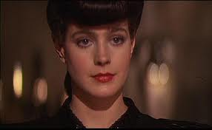
Lighting
Lighting in Film Noir
Q5 Discuss the style and effect of the lighting in the 2 images. How does the variation in lighting reflect the character development of Rachael

Slide 23
Figure placement and movement
Figure expression refers to the facial expressions and the posture of an actor, whereas figure movement refers to all other actions of the actor, including gestures.
Two of the most important aspects of film study are appropriateness of the expression of the actors and the control the director exhibits over the actor’s movements
The director causes the actors to behave in a way that supports a particular thematic element of the film.
Positioning within a frame can draw our attention to an important character/object. A film-maker can use positioning to indicate relationships between people

Slide 24
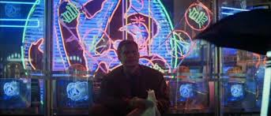
Figure placement and movement
How does the the introduction and positioning of Deckard establish a thematic element of the film?

Slide 25
Figure placement and movement
Character placement: Density and Depth
The arrangement of characters on the screen (position, size, etc.)
Dominant subject in the frame
The amount of visual information on screen
High density can symbolize chaos.
Low density can symbolize calmness
The depth of different distances at which objects are placed on screen, subsidiary contrasts

Slide 26
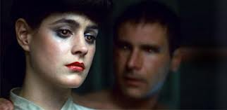
Figure placement and movement
Character placement: Density and Depth

Slide 27
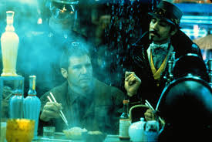
Figure placement and movement
Character placement: Density and Depth

Slide 28
Student Task
Questions 1-6
Assessment Criteria
Your response should demonstrate the following knowledge and skills
Identifies and discusses the nature of mise en scene elements
Analyses how mise en scene contribute to themes and ideas presented in the text
Understands how mise en scene elements combined with story to engage an audience
Use of appropriate terminology
Use of examples from the text to support your responses

Slide 29
Student Task
The excessive and complex visual style of Blade Runner, from costume to cityscape, is not only entirely appropriate to the film's themes but it is a crucial element in their construction.
Students are required to produce a 10-15 screen power point presentation that examines the use of mise en scene in Blade Runner and how the visual elements build and support the main themes in the text

