Slide 1
Ancient China – Inventions and achievements
Learning Intentions:
Causes and effects of contacts and conflicts with other societies and/or peoples, resulting in developments such as expansion of trade, colonisation and war, and spread of beliefs
The role and achievements of a significant individual in an ancient society

Slide 2
This week and next week, in History…
Before the 6th of September
You MUST do slides 1-12 All Tasks Due 6th of September

Slide 3
Task 1: Watch the following clips about Chinese inventions. Then do a google search and make a list of as many ancient Chinese inventions as you can find (at least 20).
Ancient China – Inventions and achievements
The Ancient Chinese were famous for their inventions and technology. Many of their inventions had lasting impact on the entire world. Other inventions led to great feats of engineering like the Grand Canal and the Great Wall of China.
Tea
Wheelbarrow
Ship Rudder
Mechanical Clock

Slide 4
Read Pearson Textbook p170-171

Slide 5
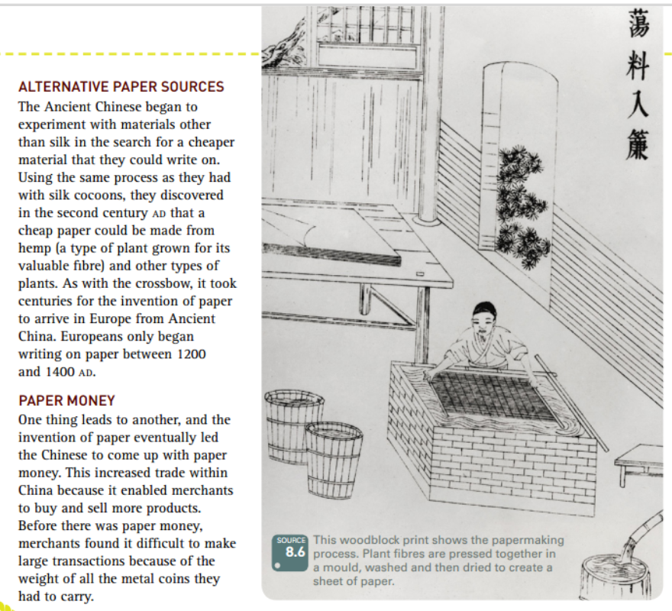
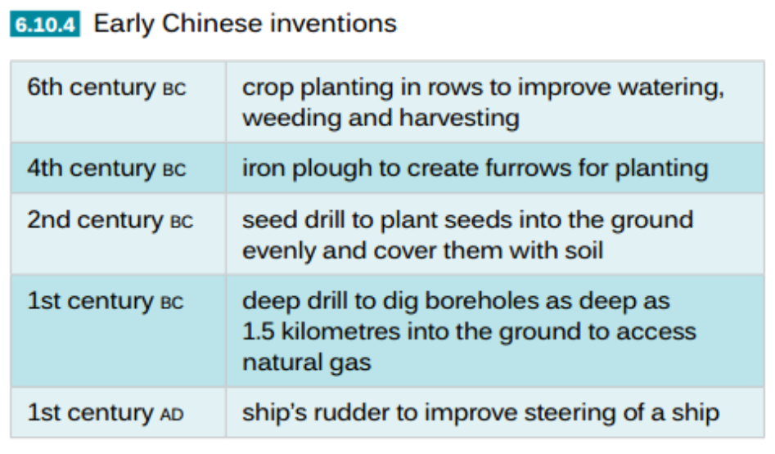
Task 2: Read through the information on slides 4 and 5 and answer the following questions.

Slide 6
Play Clip

Slide 7
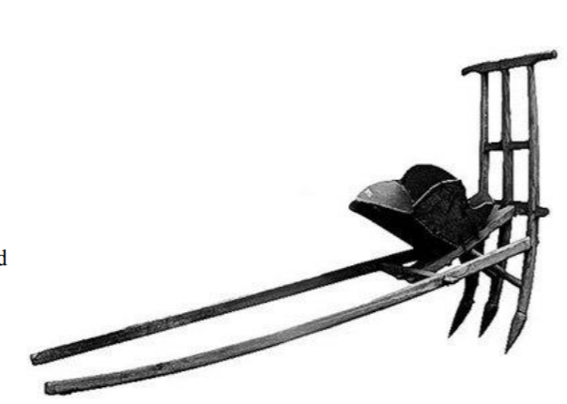
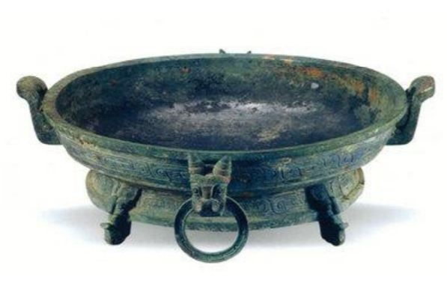
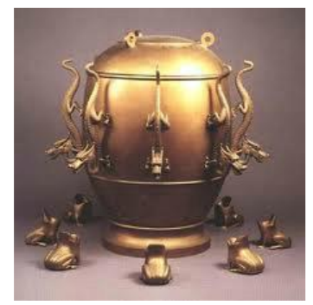
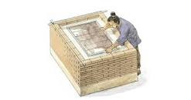
Year 7 History - Ancient Chinese Virtual Museum Exhibit Project

Slide 8
Task 3
Your exhibit must include a model or replica as well as written information.

Slide 9
Step 1:
Choose any invention or great achievement from Ancient China.
Eg. The Compass

Slide 10
Step 2:
Come up with five research questions to research and present about the invention or achievement you have chosen.
You will want to be able to write a couple of paragraphs in response to each question, so avoid questions that you can answer in only a couple of sentences.
Eg:
How was the compass invented?
How did the compass affect the society then?
Why was the compass invented?
How does the compass help us nowadays?
What advancements have been made to the compass since its invention and how is it used now?

Slide 11
Step 3:
Create a visual display where the questions are answered and your invention is displayed.
For example:

Slide 12
Step 4:
Remember to include a correctly formatted bibliography of at least five sources. Refer to your diary p13 for instructions on how to create a bibliography.

Slide 13
Step 5:
Marking Guide | Grade
The questions created by the student are detailed and cover all aspects of an invention. | /10
Answers to questions are very detailed and contain relevant and correct information. | /10
The invention is illustrated with detail and contains any relevant information. | /10
Great care was taken with the presentation and creativity of the of the project | /5
Grammar conventions. Spelling, punctuation, sentence structure and vocabulary. | /5
A correctly formatted bibliography of at least five sources has been included. | /5
Look carefully at the attached marking guide to make sure you have done everything needed for a good grade.

Slide 14
Then…. Get started!
Watch the following video clip and think about which invention you are going to do your project about.

