Slide 1
APERTURE
Photography 101- Technical

Slide 2
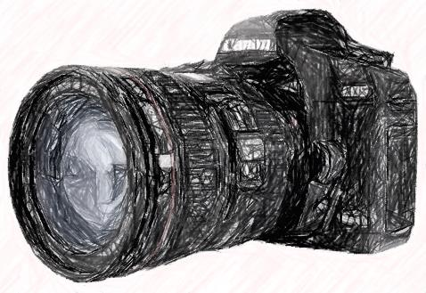
What is aperture?
Aperture refers to the AMOUNT of light that enters the camera, through the lens, or the ‘hole’ in the camera.
Once the light enters the hole in the lens, it enters the camera.

Slide 3
Think about it like this…
Think of the pupil in your eye. The ‘hole’ gets bigger or smaller depending on the amount of light that enters the eye.
This is the same for a camera lens. Making the lens bigger or smaller allows more or less light coming into the camera.
The size of the hole is the aperture.

Slide 4
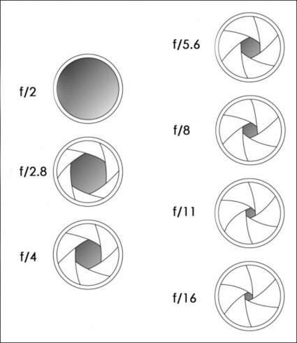
F- STOP’s
Aperture is measured in
f-stops.
Each different size hole has a different f-stop reading, or a different number.

Slide 5
Unfortunately, it gets a little more confusing…
The MORE light that enters the camera, so the BIGGER the hole, equals a SMALLER
f-stop.
The LESS light that enters the camera, is the SMALLER the hole, which means a LARGER
f-stop.

Slide 6
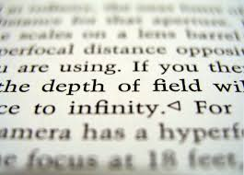
When we play around with the aperture and f-stop, we also change another aspect of our image.
This is called depth of field.

Slide 7
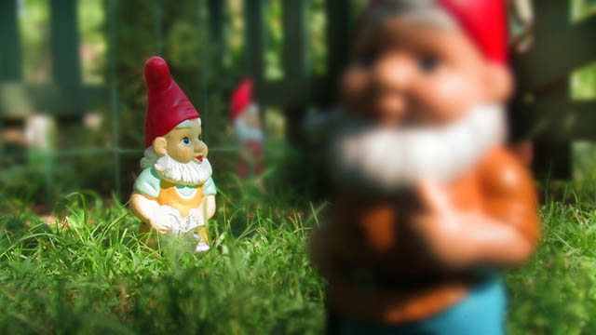
Depth of field relates to how much and what parts of the image will be in focus.

Slide 8
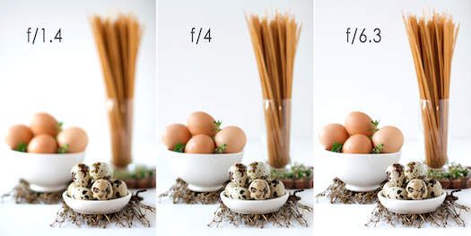
Depth of field changes

Slide 9
Small aperture (small f-stop number)
= small depth of field (most things out of focus or blurred)
Large aperture (big f-stop number)
= large depth of field (clear picture in focus)

