Slide 1
Week 4-6 Writing and Directing a
Short Suspense Film
TASK 1 YOU SHOULD READ SLIDES 1 -10 : OPEN TASK ONE SHEETS LINK
VIEW SLIDES 12- 17 AND IN THE WORKBOOK WRITE DOWN OR LIST THE SUSPENSE ELEMENTS USED
YOU SHOULD READ SLIDES 20 -36 TO EXAMINE MORE SUSPENSE TECHNIQUES
TASK 2 YOU SHOULD SELECT YOUR 3 MINUTE FILM TOPIC FROM SLIDE 38-41 AND THEN WRITE A TREATMENT IN YOUR WORKBOOK
TASK 3 WRITE A TREATMENT FOR YOUR FILM SLIDE 47 IN YOUR WORKBOOK
TASK 4 SLIDES 49-50 COMPLET A SHOT LIST IN YOUR WORKBOOK OR COMPLETE A STORY BOARD
TASK 5 FLIM AND EDIT YOUR PRODUCTION

Slide 2
Dial S for Suspense
Cinematography Week 3
The Language of Suspense

Slide 3
What is suspense?
A feeling of anxiety that accompanies uncertainty about the outcome of a scene.
According to David Howard in How to Build a Great Screenplay, suspense can be found in almost any situation that causes a change in the life of a character.

Slide 4
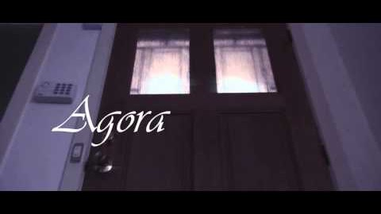
Student film
https://www.youtube.com/watch?v=tC8TscS0aZk&feature=emb_logo

Slide 5
A word from Hitchcock
Alfred Hitchcock, the master of suspense, once explained suspense by describing a bomb underneath a table. If the bomb explodes, the audience is given a shock. In a suspense film, however, the audience knows there's a bomb underneath the table. It's rigged to explode at one and the clock is ticking. "In these conditions, the same innocuous conversation becomes fascinating because the public is participating in the scene," Hitchcock explained. "In the first case we have given the public fifteen seconds of surprise at the moment of the explosion. In the second we have provided them with fifteen minutes of suspense."

Slide 6

Suspenseful scenes
The Language of Suspense

Slide 7
Suspenseful stories
Today we’re going to cover how you can create suspenseful short films
We’ll also look at the cinematic language of suspense, including:
Camera techniques. Handheld camera movement, framing, extreme close ups, close ups, point of view shots, canting, camera angle.
Mise en scène. Colour correction.
Editing. Parallel editing, pace, cutaways, slow motion.
Lighting. Low key lighting, back lighting, chiaroscuro lighting.
Sound. Diegetic and non-diegetic sound effects, music, silence, non-diegetic sound effects.

Slide 8
Audience Expectations
Creating suspense involves manipulating audience knowledge and expectations.
You can manipulate these expectations to create suspense. Imagine the opening shot of a typical slasher flick. As she walks downstairs, we cut to a shot of the camera panning across broken glass and a billowing curtain. Someone’s in the house. This knowledge helps to create suspense.
Gus van Sant’s Elephant is a film about a high school shooting. Although nothing happens for most of the film, intense suspense is created by audience knowledge that the film will end with a shooting.

Slide 9
Character Identification
If your audience doesn’t care about your characters, they won’t feel suspense.
There are a number of techniques filmmakers can use to encourage their audience to care about the characters in their film. In Secrets of Screenplay Structure, Linda J Cowgill suggests creating a connection with the audience by using universal emotions - such as fear, love, hate, injustice or embarrassment.
In Break into Screenwriting, Ray Frensham suggests finding ways to make your character familiar, likeable or intriguing to the audience.

Slide 10
Studying suspense
we are going examine a number of scenes from famous films and write about how the director has used various cinematic techniques to engage the audience. We are doing this because we want to become better at discussing film but also to improve our own filmmaking. Describing how professional directors create suspense is the first step towards using these techniques ourselves.
The following clips were taken from Misery (Rob Reiner, John Carpenters The Thing ), The Strangers (Bryan Bertino, Steven Spielberg’s Duel, Jurrasic Park , Mission Impossible
TASK ONE As we watch each clip, use the sheets provided to explain how you think camera techniques, acting, mise-en-scene, editing, lighting and sound are being used to create suspense.

Slide 11
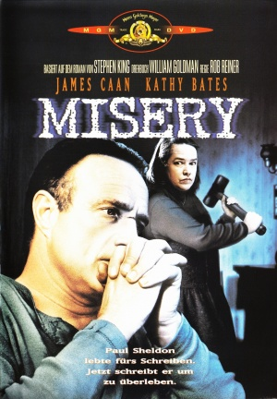
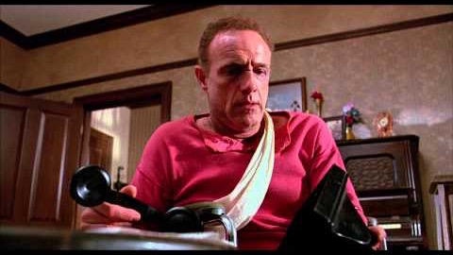
Misery
In Misery (Rob Reiner, 1990), writer Paul Sheldon is rescued from a car wreck and nursed back to health by a dangerous woman who claims to be his biggest fan. Midway through the film, when she leaves to buy some paper, the wheelchair bound Paul manages to escape from the locked bedroom and explore the house.
https://www.youtube.com/watch?v=_axcdhxe_NU

Slide 12
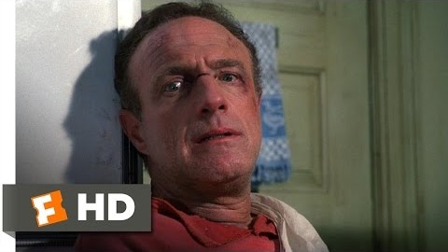
https://www.youtube.com/watch?v=SeOMiErBnks

Slide 13
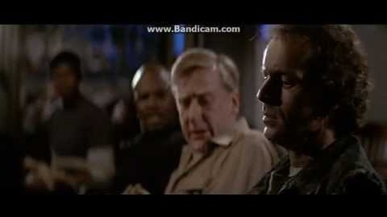
John Carpenters The Thing
https://www.youtube.com/watch?v=FgqTTKmiEwo

Slide 14
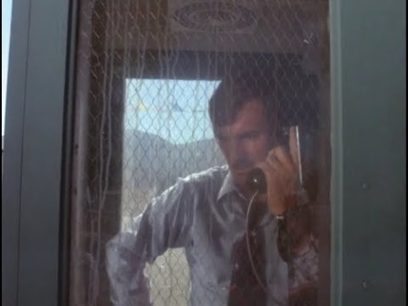
Stephen Spielberg’s Duel
https://www.youtube.com/watch?v=eOHuDMuMnes

Slide 15
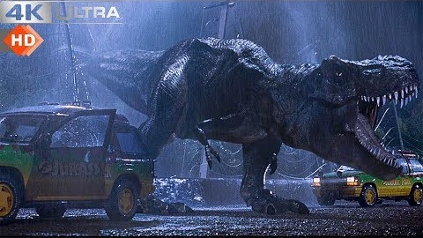
Speilbergs Jurrasic Park
https://www.youtube.com/watch?v=WSM8GcShChk

Slide 16
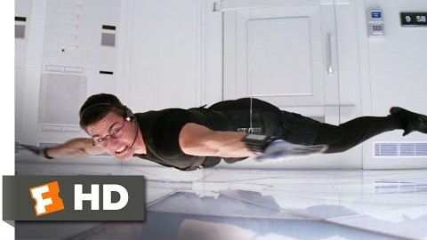
Mission Impossible
https://www.youtube.com/watch?v=ar0xLps7WSY

Slide 17
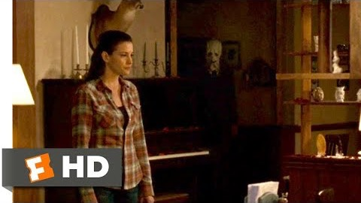
Brian Bertino The Strangers

Slide 18
Techniques for tension
Creating a suspenseful short film

Slide 19
Handheld camera movement
Handheld camera movement creates a sense of realism and suspense.
All good film makers create their own manuals – In our digital workbook in google classroom – list examples –(whether through still shot images from films or a video link) of each camera shot listed here

Slide 20
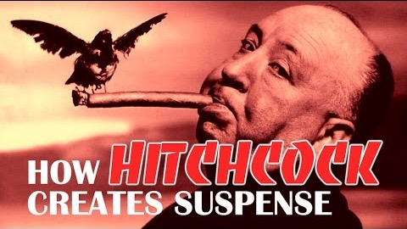
Shot size
Close ups. If there’s a threat in your scene, using a close up increases audience anxiety by putting the character closer to the unseen threat.
Extreme close ups. Used generate suspense by emphasising small details - a screaming mouth, eyes wide in terror, a knife clasped in someone's hand, a ticking clock.
https://www.youtube.com/watch?v=s-QVHJDmD6A

Slide 21
Camera framing
The framing of shots can also be used to manipulate audience expectations and generate anxiety, particularly if there is a threat lurking off-screen.
In The Village (M Night Shyamalan, 2004), Shyamalan uses framing to create suspense when Ivy Walker (Bryce Dallas Howard) is threatened by one of the creatures inhabiting the woods around her village. Standing on her front porch with her hand outstretched, Shyamalan uses space on the right hand side of the frame to imply that the threat will come from this direction. Instead, the creature emerges from the darkness in the middle of the frame.
https://www.youtube.com/watch?v=GbJpJBKUf4k&t=208s

Slide 22
Point of view
Point of view shots are another powerful way to create suspense, allowing the audience to see through the eyes of a character. This helps the audience to identify with characters and makes them feel as if they're in the scene themselves.
In Duel (Steven Spielberg, 1971), point of view shots are used extensively to encourage the audience to identify with David Mann (Dennis Weaver), a motorist who is terrified by a psychotic truck driver. When he pulls up at a gas station and the truck rumbles in beside him, director Steven Spielberg cuts from a close up of Weaver's concerned expression to point-of-view shots of the sinister truck driver as he idly kicks his tyres.
https://www.youtube.com/watch?v=LX9Y4e-3Qpk

Slide 23
Canting
Canting is another framing technique that can be used to generate suspense by creating a sense of disequilibrium. Because the shot is not level, the audience feels a mild sense of unease and anxiety.
In the opening sequence of Scream (Wes Craven, 1996), when Casey Becker starts to realise that there's something unusual about a mystery caller, director Wes Craven cuts to a slightly canted mid shot of the character which subtly helps to build suspense.
https://www.youtube.com/watch?v=x0y3OBD9RHI

Slide 24
Camera angle
Shooting characters from a high camera angle may make them look particularly vulnerable, increase audience identification and suspense.
Low angle shots can be used to make your antagonist or a location seem ominous.
In The Sixth Sense (M Night Shyamalan, 1999), Cole Sear (Haley Joel Osment) arrives at school, a place that he finds particularly terrifying and intimidating. Here, Shyamalan increases audience suspense and anxiety by using an extreme high angle to make Cole seem small and vulnerable as he stands apprehensively in front of the building.
https://www.youtube.com/watch?v=3_3vHXuNgOQ

Slide 25
Editing techniques
The suspenseful cut

Slide 26
Parallel editing
Parallel editing, cutting between two events occurring at the same time, is another trick that directors use to generate suspense.
In The Girl with the Dragon Tattoo (David Fincher, 2011), parallel editing is used to create suspense when journalist Mikael Blomkvist explores the house of Martin Vanger. Wind whistling ominously, Blomkvist opens the door. "Martin?" he calls out hesitantly. Fincher cuts to a shot of Vanger's car crossing a bridge as he returns home. Blomkvist walks into the house slowly and there is a close up of him taking a knife for self defence. For a few tense, silent minutes, Blomkvist explores the house. The tension begins to rise when Fincher cuts back to Vanger's car rolling into the driveway. Cornered, Blomkvist has to evade him in a silent game of cat-and-mouse.

Slide 27
Cut aways
"Suspense is essentially an emotional process," Alfred Hitchcock once explained. "Therefore you can only get the suspense element going by giving the audience information."
In Psycho (Alfred Hitchcock, 1960), director Alfred Hitchcock uses a cutaway to create suspense when private investigator Milton Arbogast investigates the Bates house. As he slowly climbs the stairs and the suspenseful music increases in intensity, Hitchcock cuts away to a shot of a door opening. This cutaway creates anxiety and increases suspense by implying that the malevolent Mrs Bates is nearby.
https://www.youtube.com/watch?v=5bieIiX5KLQ

Slide 28
Slow motion
Slow motion is an excellent way to increase tension by drawing out a scene.
In Unbreakable (M Night Shyamalan, 2000), slow motion is used to generate suspense in the film's climatic scene. David Dunn (Bruce Willis) is pushed from a balcony by a vicious murderer. When he lands on a pool cover, Shyamalan cuts to several slow motion point of view shots as it slips into the water, building agonising suspense before abruptly cutting back to real time as David plunges beneath the surface.

Slide 29
Sound and music
Creating suspense with sound

Slide 30
Diegetic sound
Diegetic sound can also be used to create suspense and build tension.
In David Fincher's Zodiac, when Robert Graysmith (Jake Gyllenhaal) thinks he might be trapped inside the house of a serial killer, he races towards the front door. In the background, the diegetic sound of a kettle boiling is used to increase suspense.
https://www.youtube.com/watch?v=VIy-X8-pEoU
https://www.youtube.com/watch?v=x7IcPGaswBQ

Slide 31
Silence
While diegetic sounds can be used to create suspense, silence is also very important. As a filmmaker, you need to think of how you can use periods of silence to build up the suspense in your film.
In The Lovely Bones, director Peter Jackson uses silence to nail-biting effect when as Lindsey Salmon searches for evidence in the house of serial killer George Harvey. Jackson lingers on a shot of Harvey standing backlit on the basement steps, listening. He cuts back and forth between Harvey and Lindsey, using silence to create unbearable tension.

Slide 32
Silence
In Munich (Steven Spielberg, 2005), sound editing is used to emphasise the drama and suspense of a botched terrorist bombing. When Avner Kaufman (Eric Bana) realises that the daughter of their target will die in the blast, he desperately tries to stop the detonation. At this moment, all the diegetic sound in the scene fades out and is replaced by a suspenseful rumble and the sound of another agent fumbling to insert the key into the detonator.
Diegetic and non diegetic sounds

Slide 33
Lighting
Creating suspense with lighting

Slide 34
Lighting
Low key lighting is a staple of suspense films.
In Signs, a family seeks refuge from alien invaders in their basement. When one of the characters accidentally smashes a lightbulb, there are a few suspenseful minutes as the film is plunged into complete darkness.

Slide 35
Colour correction
When you're making a suspense film, editing programs allow you to tweak the colour of your film to increase audience anxiety.

Slide 36
Suspenseful stories
Developing a suspense film

Slide 37
Three Minute Thriller
Using one of these pre-planned scenarios, create a three minute thriller. Your emphasis should be on creating a polished and professional short film that uses cinematic techniques in a polished way to engage the audience.

Slide 38
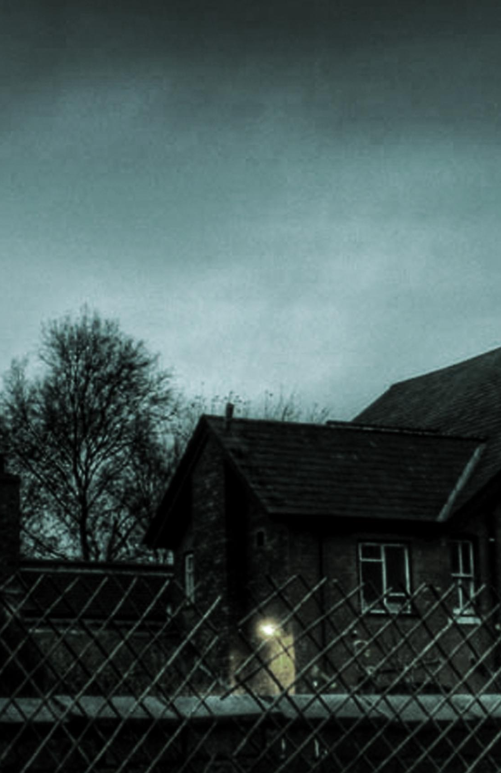


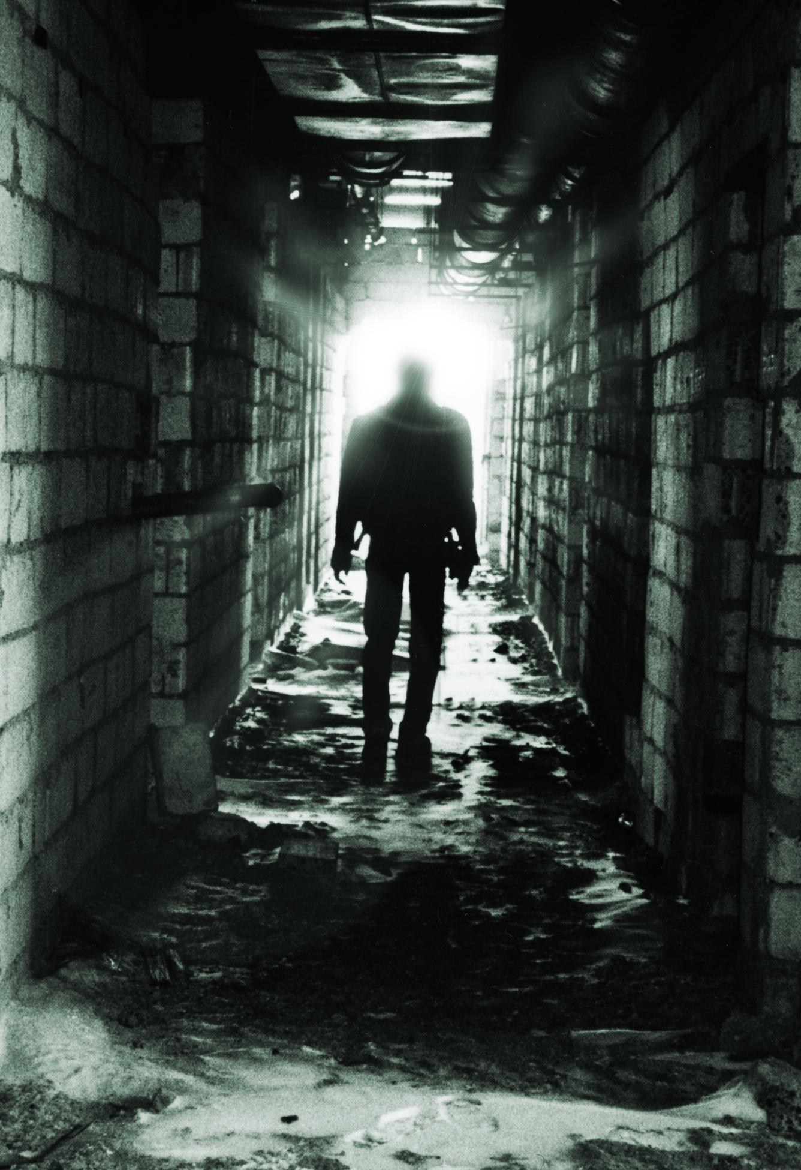
Three Minute Thriller
Alone
Files
Late
Stalker

Slide 39
Three Minute Thriller
Attempting to steal files from a computer is a classic suspense scenario that provides an excellent opportunity for rising tension. Use parallel editing to cut from the progress bar, the anxiety on your protagonist's face and the footsteps as someone returns to the room.
Files

Slide 40
Three Minute Thriller
Your main character is late for school. Another great scenario with the possibility of rising tension - missing the bus, waiting at the traffic lights, dropping school books. Frequent point of view shots of a wristwatch will help increase suspense. When your character finally gets close to their destination, the ticking hands of a classroom clock will help to build further suspense.
Late

Slide 41
Three Minute Thriller
Your main character is alone, walking home quickly, when they feel an overwhelming sense that they're being followed…Use close ups of the anxiety on your protagonist's face and make them seem closer to the threat. In a scenario like this, parallel editing can be used to show the approaching stalker. Point of view shots from the perspective of your protagonist and antagonist will also help to contribute audience anxiety.
Stalker

Slide 42
Planning suspense
Select a family member or yourself
Select a location that is accessible and safe and within covid guidelines

Slide 43
Planning suspense
Remember, you film shouldn’t include violence, language, driving, sex scenes, drug use, nudity or anything dangerous.
Keep it simple, keep it creative - use the cinematic language of suspense rather than content to ratchet up suspense.

Slide 44
Planning suspense
When planning your story, think about:
  how you can provide the character with obstacles the provide increasing difficulty.
  opportunities to remind your audience what the stakes are.
  how you can encourage your audience to identify with your characters. If an audience is emotionally invested in a character, they're more likely get caught up in the suspense and drama of your film.

Slide 45
Three Minute Thriller
There's a suspicious noise downstairs. Trees scratch against the window ominously and thunder rumbles in the distance. Low key lighting, eerie music and point of view shots will help to make this scene suspenseful. Don't forget to establish your character as likeable so that your audience cares about their fate!
Alone

Slide 46
Planning suspense
Think about opportunities to create suspense using: handheld camera movement, framing, extreme close ups, close ups, point of view shots, canting, low angles, high angles, parallel editing, pace of editing, cutaways, slow motion, low key lighting, back lighting, diegetic sound, music, silence, non-diegetic sound.

Slide 47
Submitting your Digital Work book in Google Classroom
View this video

Slide 48
Writing a treatment
TASK 3
A treatment is a description of what happens in your story from beginning to end. This is an extremely powerful way to play around with your story without having ideas set in concrete.
Write an outline of what you’d like to happen in your story, in your DIGITAL WORK BOOK think of opportunities for rising tension, character identification and how you can use cinematic techniques to create suspense.

Slide 49
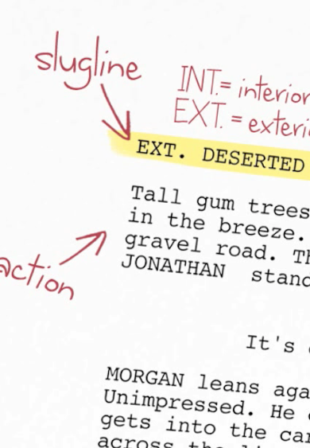
Writing a screenplay
A screenplay is the script for you film.
To learn how to write a screenplay, read the video and information here: https://lessonbucket.com/filmmaking/filmmaking-filmmaking/screenplay/

Slide 50
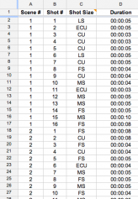
Writing a shotlist
TASK 4
A shot lists is simply a list of every shot in your film.
To learn how to create a shot list, visit this link: http://lessonbucket.com/filmmaking/storyboards/
Sharing the Google Docs Shot List template is a great way to collaborate with others on the activity.

Slide 51
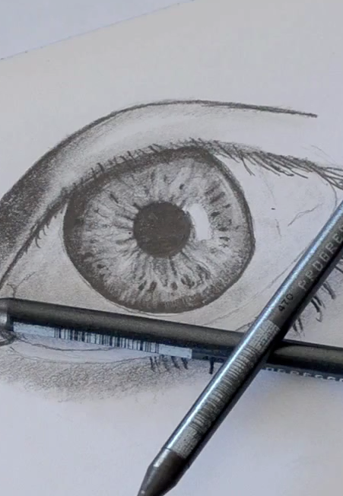
Drawing storyboards
Storyboards are a terrific way to previsualise your film. If you’re not great at drawing, you can use digital cameras and mobile apps to help plan the look of your film.
To learn a variety of techniques for storyboarding, visit this link: http://lessonbucket.com/filmmaking/storyboards/

Slide 52
Filming your 3 Minute Thriller
Once you have completed your Treatment and Shot list – you will now have your Media classes to film and edit your production –
Please use the time devoted to this stage of production
TASK 5

