Slide 1
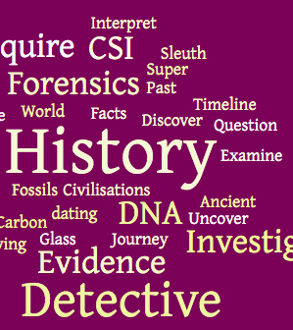

Slide 2
HISTORY TERM 3 WEEK ONE
YOU MUST READ AND RESPOND TO SLIDES 2-6 AND COMPLETE TASKS 1 AND 2
YOU SHOULD READ AND RESPOND TO SLIDES 8-10 AND COMPLETE TASKS 3 AND 4
YOU COULD READ AND RESPOND TO SLIDE 11 AND COMPLETE TASK 5

Slide 3
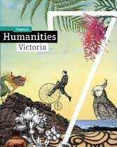
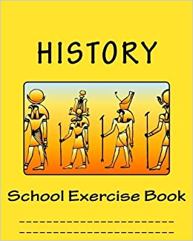
YOUR WORKBOOK
During Semester 2 the Year 7 humanities course focuses on History.
Students should make sure you have your own workbook in which to complete all of your work in History.
You will also be using your History textbook (hardcopy) in class.
Only when instructed are students to use a digital workbook or textbook in class

Slide 4
TASK 1
Create a cover page in your workbook –using an interesting collage of History related images or create a Word Cloud which you can paste into your workbook when we are back at school

Slide 5
YEAR 7 HUMANITIES : SEMESTER 2 HISTORY MARY’S HISTORY WORKBOOK

Slide 6
HERO TRAILER
TASK 2
Create the Heading
“Hero Trailer”
in your digital workbook
View the Trailer from the link
below and answer
the 4 questions to the right
What country is being portrayed?
What period of history does this clip show?
What appears to be happening?
What else did you see? Clothes, weapons etc.

Slide 7
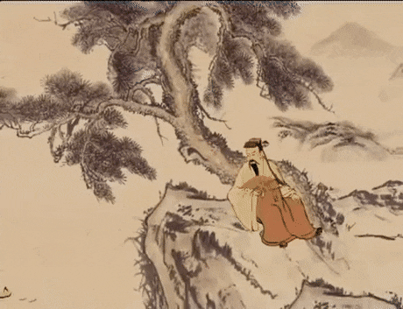
ANCIENT CHINA
AN IN DEPTH STUDY

Slide 8
WE WILL BE LOOKING AT THE FOLLOWING OVER THE NEXT FEW WEEKS.
How and where did the civilisation of Ancient China develop?
What archaeological discoveries and types of evidence have enabled historians to understand Ancient Chinese society?
Who and which philosophies shaped Ancient China?
Technological discoveries of Ancient China.

Slide 9
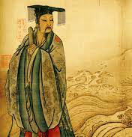
TASK 3
READ PEARSON PAGES 146-147(on next slide or online at Pearson)
1. ADD THE DYNASTIES TO A TIMELINE YOU WILL MAKE USING 2 A3 SHEETS JOINED TOGETHER
2.FOLD AND PASTE YOUR TIMELINE INTO THE FRONT OF YOUR WORKBOOK (if your workbook is at school, we will add it when we get back)

Slide 11
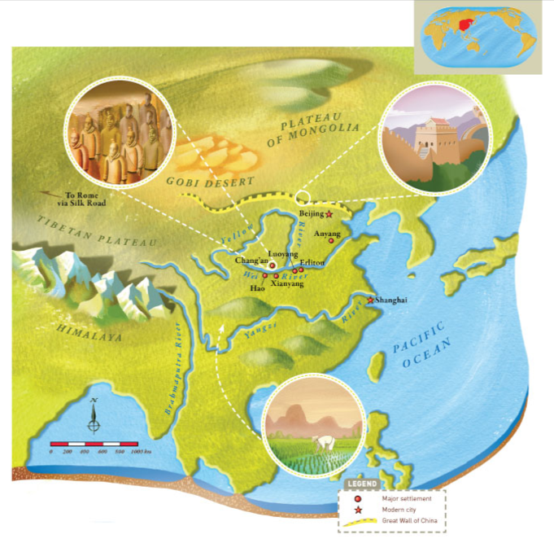
TASK 4
Read Pearson Pages 148-149 (on next slide or at Pearson)
Complete:
Activities 1-5 only
In your Workbook

Slide 13
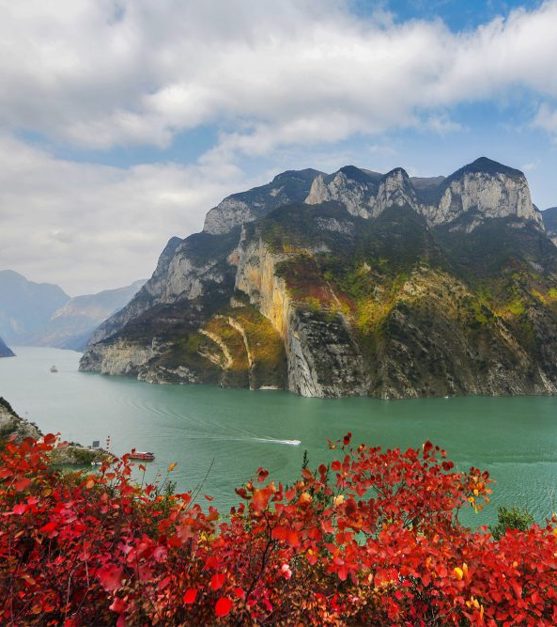
THE YANGZI AND YELLOW RIVERS
TASK 5
RESEARCH - CUT AND PASTE AN IMAGE OF THE YANGZI AND YELLOW RIVER
FROM PAGE 149 COMPLETE QUESTION 6 EVALUATING THE IMPORTANCE OF THE TWO MAJOR RIVERS TO THE DEVELOPMENT OF ANCIENT CHINESE CIVILISATION

