Slide 1
Media Representation
Year 11 Unit One

Slide 2
What is a Media representation
A Media representation is a reflection or re presentation of reality ,made for a specific audience to achieve a specific purpose
Examining re presentations of reality can reveal a lot about the society that created them.
The aim of a representation is to re present reality as realistic as possible
A representation is a constructed media text. Representations can take many forms, including: radio segments, newspaper articles, photographs, films, and television programs, television news segments. While some media texts – like television news and documentary films – may seem realistic, we have to remember that this is not the same as experiencing it ourselves. At best, the media can only represent reality. What we see on our television screens and on the front page of our daily newspapers is someone else’s interpretation of events, ideas and people. Someone has constructed these texts.

Slide 3
Purpose of a representation
All representations are constructed with a particular purpose in mind .The author creates a product to reveal and reflect certain key pieces of information that they want the audience to understand
In every representation the background and intention of the author can influence the reading of the media product . However the audience will bring their own background , understanding and knowledge of the product being read
What is important however is the attempt by the author to position you to think and feel in a particular way

Slide 5
Selection and Omission
As representations are constructed from reality it is impossible to include everything that reality has to offer
What is left out is referred to as omission
What is left in is the selection
E.g – if we were representing a school – it would be impossible to include the whole school in an image. Choices need to be made as to what to leave in and out . There are certain things that could assist in immediately identifying it as a school – The information included would depend on how the author wanted to portray the school

Slide 8
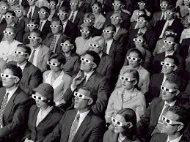
Audience
As with all media products representations are made with a specific audience in mind.
Understanding the audience is essential for the author to ensure the representation fulfils its purpose. Knowledge of the audience is therefore vital
Knowing what the audience likes and dislikes are two basic things that an author needs to know in order to create a representation for a particular audience

Slide 9
Media Codes and conventions
Codes and conventions are tools used by the author to create ( or encode) representations. Likewise the audience uses codes and conventions in order to understand ( or decode) representations
Media codes can be technical or written or symbolic
Technical codes includes the CAMELS- camera Acting Mise ens Scene- ( visual composition) editing Lighting and Sound
When these codes are used in ways that help an audience understand a representation they are known as media conventions
Conventions are the set of accepted rules or ways that media producers create meanings

Slide 10
Conventions
Here is a good definition to help solidify your understanding of the concept: “As a type of film or television develops, filmmakers and directors find certain techniques that become useful or effective in creating texts. These techniques get used again and again, and eventually they are associated with and are used to define certain types of texts. The techniques then become known as conventions.”
In this segment, Charlie Brooker points out the conventions of television news. Conventions often lend themselves to parody because, although we have a deep understanding of how media texts are organised, we often don’t think consciously about the conventions of media texts

Slide 11
https://www.youtube.com/watch?v=aHun58mz3vI

Slide 12
Codes and Conventions
Using media codes the structure of a story , its characters and genre can be communicated through common conventions , as can the way the audience understands the effect of specific events or the way time passes in a story
An understanding of conventions dictates how codes are used in order to create meaning. By using conventions an author ensures that the representation they make is understood by the intended audience as they are used to , and expecting , certain events and behaviours.
E.g – we arrange our letters into understood words , sentences and paragraphs to create meaning . If we misspell a word or don’t construct a sentence correctly meaning can be lost – This is the same with representations – if an author doesn’t construct it in an understood way , it can be difficult for audiences to understand what is meant

Slide 14
Symbolic Codes
Symbolic codes are where a visual object or piece of audio possesses greater meaning than just the literal. Symbolic codes can be broken down into the following categories.
Symbols carry meaning of which the audience needs prior understanding in order to interpret –otherwise these symbols are meaningless –Symbols like Mars( Male) Venus ( Female) , signs of the zodiac or peace or Mercedes Benz all require prior understanding as the symbols themselves don’t carry any suggestion of associated meaning – These symbols are reliant on the audience possessing additional information to create meaning

Slide 15
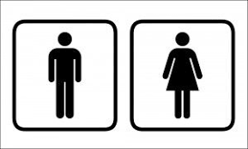
Symbolic codes
Iconic signs – are pictographs that are the nost basic representation of the original object. As these don’t rely on any additional information being possessed by the audience , they can be interpreted without prior knowledge
For example the male/female figures on toilet doors to indicate the gender don’t require specialist knowledge to decipher their meaning. Similarly with speed humps or other traffic signs , iconic signs can be decoded without prior knowledge being needed

Slide 16
Symbolic Codes
Index Signs – are the most common symbolic codes used in the construction of representations . Index signs refer back to the connotative meaning that society has for things such as objects, colours, expressions or clothing .
For example a red rose is not just a coloured fragrant flower –it is also Western societies symbol of love and romance . Similarly if a character is wearing a baseball cap it may be to keep the sun off , but if it was worn backwards additional meaning is created to the character

Slide 17
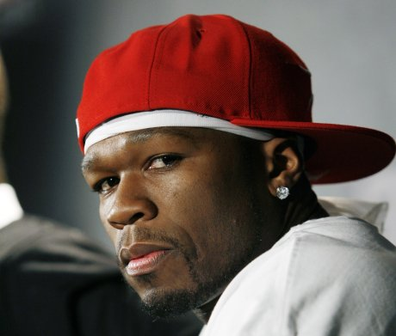

Slide 18
Written Codes
As a society we respect the written word , written codes are incredibly powerful in anchoring the meaning of a representation through the use of text within the world of the representation (diegetic)
By using written codes , an author can remove any confusion that may be caused through an element of the representation that could produce multiple meanings.
In Television or movies text is often used at the beginning of a scene to indicate the time and location in which a scene is set . As an audience we do not question this , demonstrating the power of written codes

Slide 20
Technical Codes
Technical codes are the codes of construction . Whilst each medium has unique technical codes and conventions for their use , there are some which are shared by all. For instance a close up is always going to be used to suggest power and significance.
Technical codes in Audio /Visual mediums can include camera angles/ shot sizes/ camera movement/ and editing conventions. Some example of editing conventions are montages , cut aways , reaction shots, the construction of settings, acting and movement, the timing and use of sound , the size and placement and font of credits, subtitles or captions and the use of filters or effects
In Print Media –technical codes include – cropping , the use of captions , columns,size , colour and placement of fonts or the use of filters or effects

Slide 21
Sound Codes
In Audio visual representations , an audience exprects sound to accompany a moving image , as sound codes are used to enhance the realism or emotion within the construction. Sound codes consist of dialogue , sound effects or soundtrack and can either be diegetic or non diegetic in nature
When we view a character talk to another character or interact with an object , we expect to hear appropriate voices or noises . If this dialogue or audio effects are not consistent with our expectations , we become distracted and begin to question the authenticity of the representation
When watching movies we also expect non-diegetic codes to be used . If a character begins narrating a scene , we understand the convention that the story is being told from their perspective. We also understand the audio code of the soundtrack is used to create the mood of the scene

Slide 22
Representing Identity
For your first visual task in Year 11 Media you are required to complete
1. An advertisement
2.A Magazine Cover
Details are here
During kickstart students took some photos – you can use these are take new oned

